Slide 1
Online Voting System

Slide 2

Hello! Everyone
I Bhumit Bedse(19CP012) and my group members Ujef Malek(19CP013) and Jimish Ravat(19CP015)

Slide 3
Concept
1

Slide 4
Concept
To make the voting system online
To reduce the cost of the election commision
To go to the path of digital era

Slide 5
Web page Flow
Now we shall see the flow of our web pages.

Slide 6
Homepage
If clicked on button
User can browse other pages
Vote Now
( Button )
Candidate
Login As Admin
Login As Voter
Results
All Admin panels
You can’t vote
You can vote
About us
Contact us

Slide 7
Backend
Now we shall see some backend.

Slide 8
Backend
Languages used in Backend
PHP
JavaScript

Slide 9
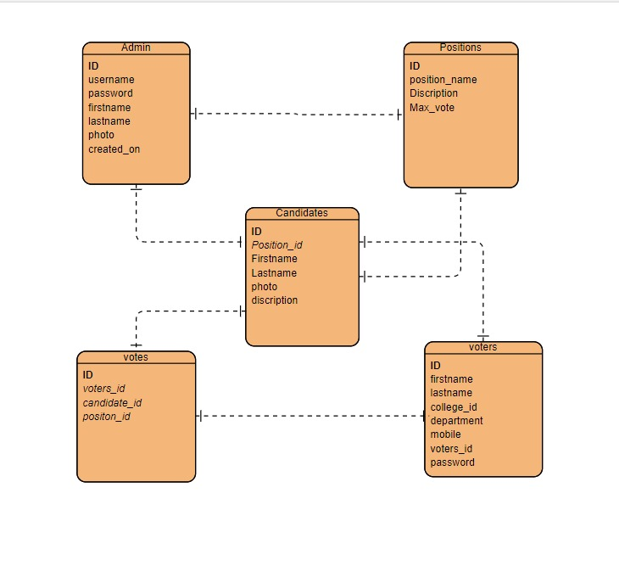
ER Diagram

Slide 10
Thanks!

